Slide 2
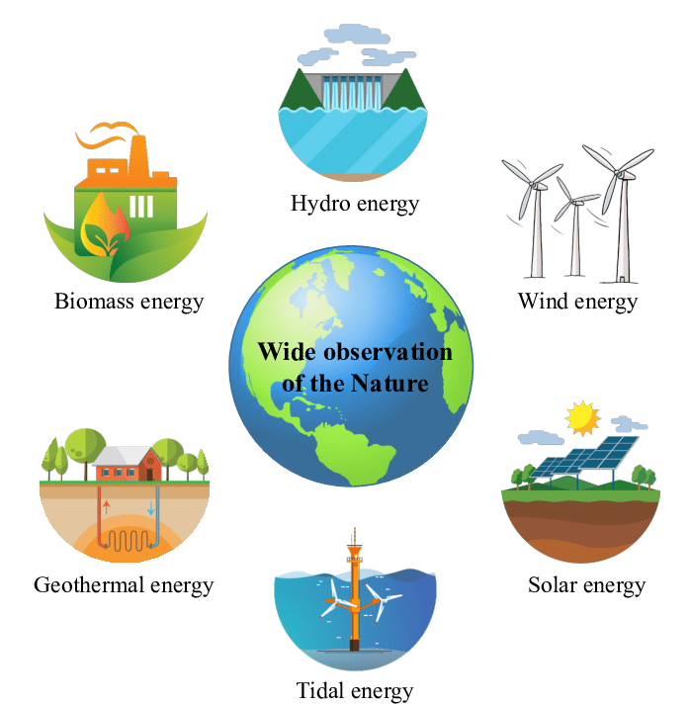
Unit
10
ENERGY SOURCES
LESSON 5: SKILLS 1
Unit

Slide 3
OBJECTIVES
By the end of the lesson, students will be able to:
+ Reading: read for specific information about renewable and non-renewable sources of energy
+ Speaking: talk about advantages and disadvantages of different sources of energy

Slide 4
LESSON 5: SKILLS 1
WARM-UP
Game: Hangman
Task 1: Discuss the questions.
Task 2: Read the text and choose the best option to complete the sentences.
Task 3: Read the text again and answer the questions.
READING
Task 4: Work in groups. Discuss and put the following words or phrases in the appropriate columns.
Task 5: Work in pairs. Ask and answer questions about the advantages and disadvantages of different energy sources.
SPEAKING
CONSOLIDATION
Wrap-up
Homework

Slide 5
LESSON 5: SKILLS 1
WARM-UP
Game: Hangman
Aims of the stage:
To introduce the topic of reading

Slide 6
WARM-UP
R E N E W A B L E

Slide 7
LESSON 5: SKILLS 1
WARM-UP
Game: Hangman
Task 1: Discuss the questions.
Task 2: Read the text and choose the best option to complete the sentences.
Task 3: Read the text again and answer the questions.
READING
Aims of the stage:
To provide students with some lexical items before reading the text.

Slide 8
READING – VOCABULARY
produce (v)
= to make things, mostly in large quantity
Examples:
Companies produce many toys for children before Christmas.
/prəˈdjuːs/
sản xuất

Slide 9
READING – VOCABULARY
limited (adj)
= not very great in amount or extent
Examples:
Coal is limited.
/ˈlɪmɪtɪd/
bị hạn chế

Slide 10
READING – VOCABULARY
available (adj)
= that you can get, buy or find
Examples:
The coal takes a long time to be available again.
/əˈveɪləbl/
có sẵn

Slide 11
READING – VOCABULARY
Advantage (N)
/ədˈvɑːntɪdʒ /
Lợi thế
/

Slide 12
READING – VOCABULARY
Disadvantage (N)
/ˌdɪsədˈvɑːntɪdʒ/
Bất lợi
/

Slide 13
READING – VOCABULARY
Rely on (v)
/ˌrɪˈlaɪ ɒn /
Phụ thuộc vào
/

Slide 14
READING – VOCABULARY
Heat(v)
/hit /
Sưởi ấm
/

Slide 15
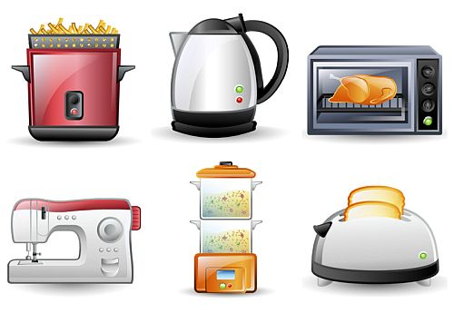
READING – VOCABULARY
Electrical appliances (n)
/ɪˈlɛktrɪkəl əˈplaɪənsɪz/
Thiết bị điện

Slide 16
READING – VOCABULARY
HOW YOU REMEMBER WORDS
ENGLISH | VIETNAMESE
PRODUCE
 | BỊ HẠN CHẾ
AVAILABLE
 | LỢI THẾ
DISADVANTAGE
 | PHỤ THUỘC VÀO
HEAT
 | THIẾT BỊ ĐIỆN

Slide 17
READING – VOCABULARY
HOW YOU REMEMBER WORDS
ENGLISH | VIETNAMESE
PRODUCE (V) | SẢN XUẤT
LIMITED (ADJ) | BỊ HẠN CHẾ
AVAILABLE (ADJ) | CÓ SẴN
ADVANTAGE (N) | LỢI THẾ
DISADVANTAGE (N) | BẤT LỢI
RELY ON (V) | PHỤ THUỘC VÀO
HEAT (V) | SƯỞI ẤM
ELECTRICAL APPLIANCES (N) | THIẾT BỊ ĐIỆN

Slide 18
READING
1
Work in pairs. Discuss the following questions.

Slide 19
READING
2
Read the text and choose the best option to complete the sentences.
1. Non-renewable sources are cheap and ______.
A. available B. easy to use C. expensive
2. ______ come from the sun, wind or water.
A. Renewable sources B. All energy sources C. Non-renewable sources
3. When energy comes from water, we call it ______.
A. wind energy B. solar energy C. hydro energy
4. Renewable energy sources are better for ______.
A. the environment B. our cars C. hydro energy

Slide 20
READING
3
Read the text again and answer the questions.
1. How many energy sources are there? What are they?
_________________________________________________________
2. What do non-renewable sources include? _________________________________________________________
3. What are the advantages of renewable energy?
_________________________________________________________
4. What will we rely more on in the future?
_________________________________________________________
There are two. They are non-renewable and renewable.
They include coal, oil and natural gas.
It’s available, clean, and safe to use.
We will rely more on renewable energy sources in the future.

Slide 21
LESSON 5: SKILLS 1
WARM-UP
Game: Hangman
Task 1: Discuss the questions.
Task 2: Read the text and choose the best option to complete the sentences.
Task 3: Read the text again and answer the questions.
READING
Task 4: Work in groups. Discuss and put the following words or phrases in the appropriate columns.
Task 5: Work in pairs. Ask and answer questions about the advantages and disadvantages of different energy sources.
SPEAKING

Slide 22
SPEAKING
4
Work in groups. Discuss and put the following words or phrases in the appropriate columns.
run out limited easy to use cheap expensive
available safe to use good for the environment
Advantages | Disadvantages
easy to use
run out
cheap
limited
available
expensive
safe to use
good for the environment

Slide 23
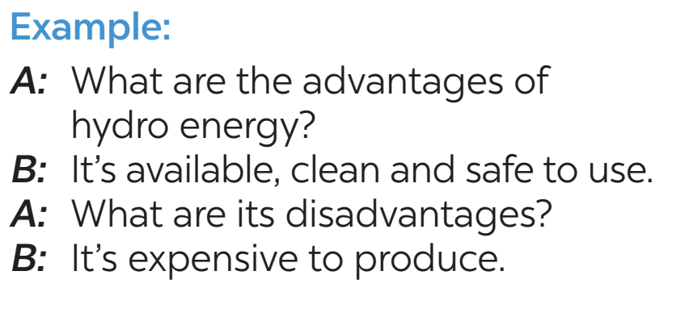
SPEAKING
5
Work in pairs. Ask and answer questions about the advantages and disadvantages of different energy sources

Slide 24
LESSON 5: SKILLS 1
WARM-UP
Game: Hangman
Task 1: Discuss the questions.
Task 2: Read the text and choose the best option to complete the sentences.
Task 3: Read the text again and answer the questions.
READING
Task 4: Work in groups. Discuss and put the following words or phrases in the appropriate columns.
Task 5: Work in pairs. Ask and answer questions about the advantages and disadvantages of different energy sources.
SPEAKING
CONSOLIDATION
Wrap-up
Homework

Slide 25
CONSOLIDATION
1
WRAP-UP
READING
SPEAKING

Slide 26
CONSOLIDATION
2
HOMEWORK
Do exercises in the workbook.
Prepare for the next lesson: Skills 2

Slide 27
Website: sachmem.vn
Fanpage: facebook.com/sachmem.vn/

